Slide 1

Loan Approval Likelihood
Team Members: Desiree Diaz, Medina Izgutdina, Irene Okada, Wei Zhu

Slide 2
Hypothesis:
Married men with a graduate degree are more likely to qualify for the highest loan amount
Data source:
Loan Prediction Problem Dataset | Kaggle
Inputs:
Credit history, Loan amount, Loan term, Applicant salary, Co-applicant salary, Resident location type (Rural, Urban, Suburban), Number of Dependents, Marriage status, Graduate status, Employment status, Approval status

Slide 3
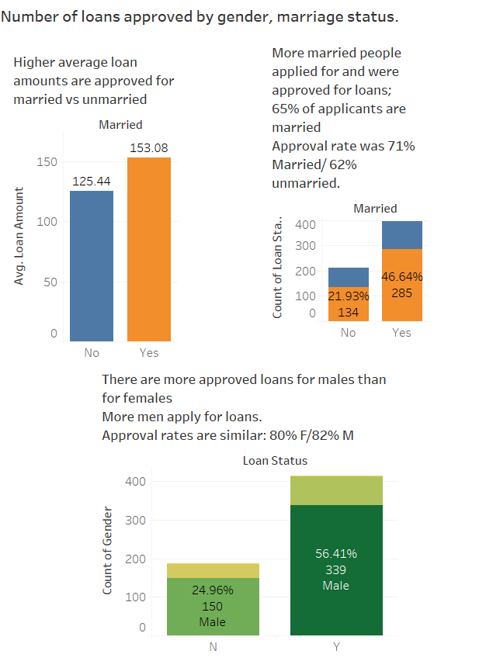
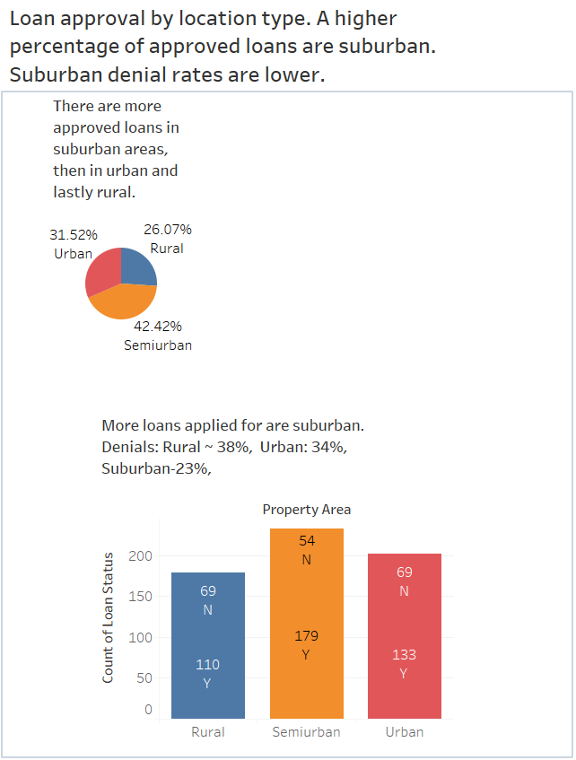
Gender and Marriage
Location

Slide 4
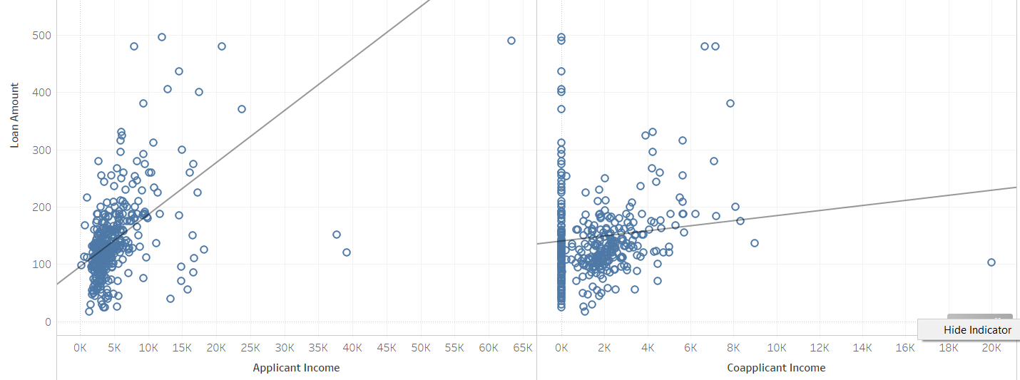
Income vs Loan amount: Applicant income alone is a better indicator of a higher loan amount than co-applicant income alone

Slide 5
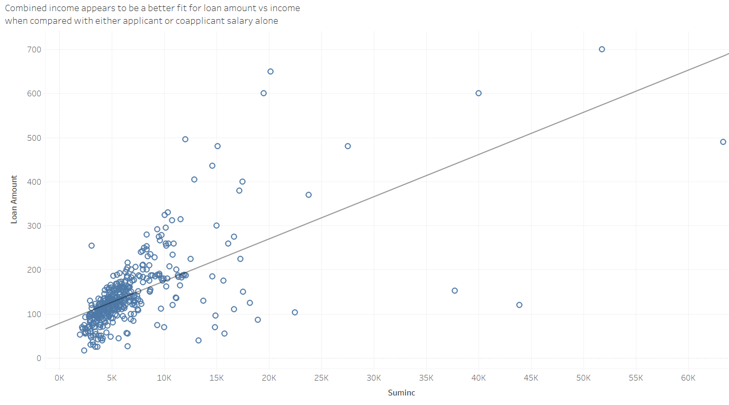
Combining applicant and co-applicant incomes appears to indicate a better fit for loan approval than either one alone

Slide 6
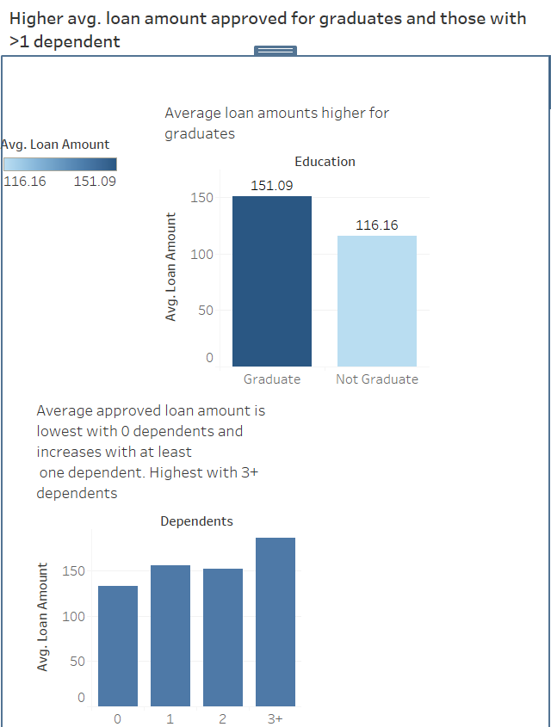
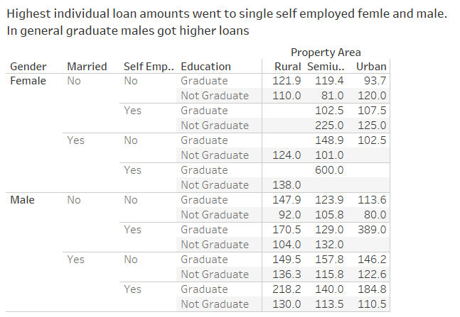

Higher loan amounts are approved for graduates vs non-graduates. Self- employment also appears to be a positive factor
https://public.tableau.com/profile/ireneokada

Slide 7
Descriptive Summary
Approval Rates:
Overall approval rates were similar for men and women, but higher for those who were married, graduates and those who lived in the suburbs
Loan Amounts:
Overall average loan amounts seem higher for graduates, those with a co-applicant and those with >1 dependent

Slide 8
Explanatory model
Dependent variable (y): Loan Approval (Y/N)
Independent/predictor variables (X):
Credit history
Loan amount
Loan term
Applicant salary
Co-applicant salary
Resident location type (Rural, Urban, Suburban)
Number of Dependents
Marriage status
Graduate or not
Self-employed or not

Slide 9
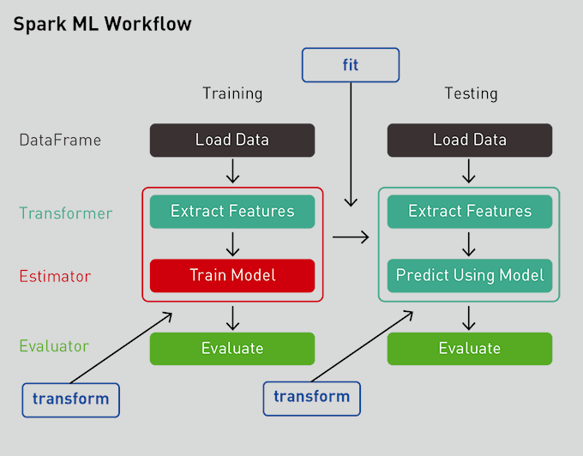
Model: Gradient Boosting Classifier with Pipeline ML workflow
•Model Used: Gradient Boosting Classifier •We used pipeline from sklearn library to optimize the coding process and standardize workflow •This helped with pre-processing of our data and transforming of categorical data •Pipeline enables a sequence of data to be transformed and correlated in a model that can be tested and evaluated to achieve an outcome, this improves ”fit” •Created ML model was trained on the existing dataset •The learning algorithm finds patterns in training data that maps input data to the target (or outcome to be predicted) •Accuracy of this model was ~ .85

Slide 10
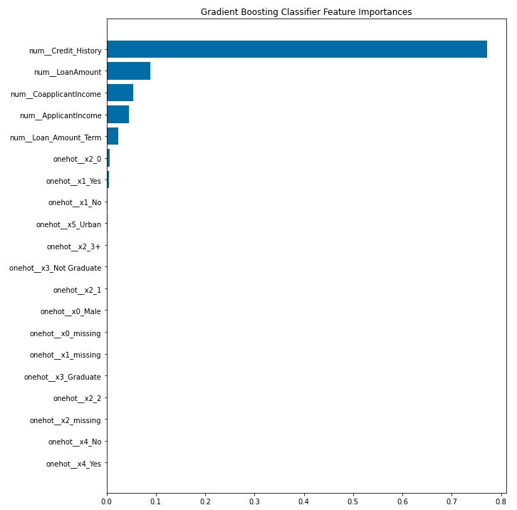
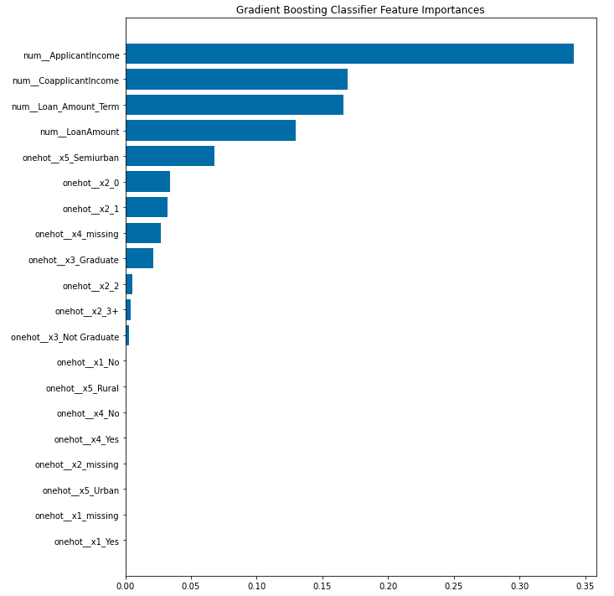
Featured factors in loan approval are Credit History, Loan Amount, Applicant and Co-applicant Income. When Credit History is removed importance expands to Suburban location and those with 2-3 Dependents
✱
Notes:
One-Hot Encoded:
0 Gender (Male/Female)
1 Married (Y/N)
2 Dependents (0, 1, 2, 3+)
3 Education (Graduate/Not Graduate)
4 Self-Employed (Y/N)
5 Property type (Urban, Semiurban, Rural)

Slide 11
Conclusion
The statistical model appears to agree somewhat with descriptive data but takes a more precise look at predictive variables, allowing us to predict loan approval with an accuracy of .85
Our hypothesis appears not to be proven; neither gender nor property location type appear in the top predictive variables.

Slide 12
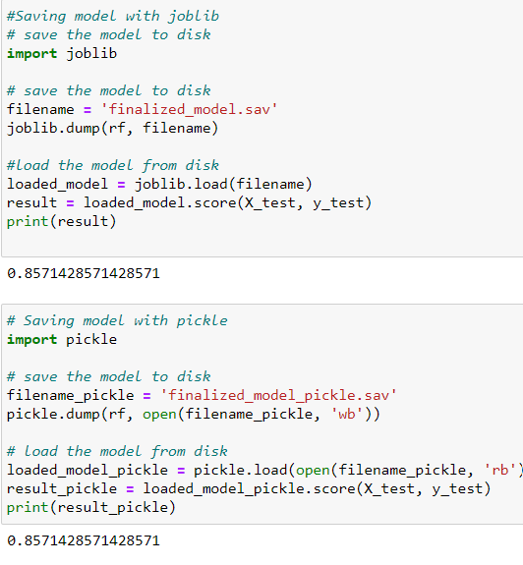
The model has an accuracy of .85

Slide 13
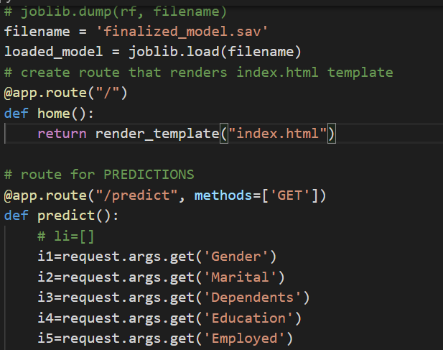
Model saved and loaded into app
Based on the model, Loan Application was designed

Slide 14
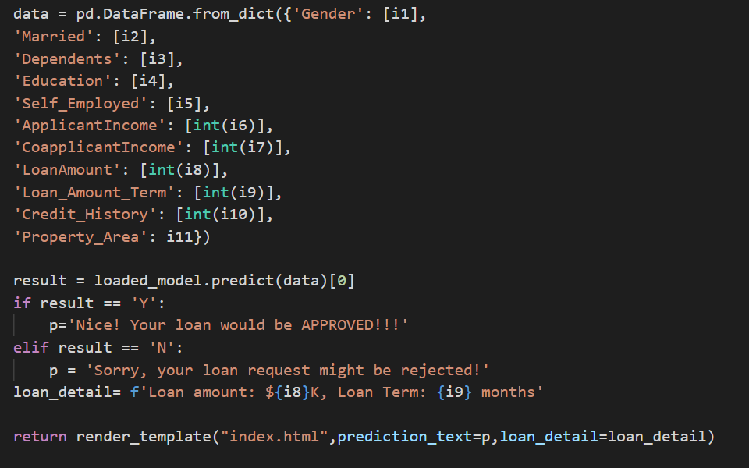
Inputs from model used to code loan application app

Slide 15
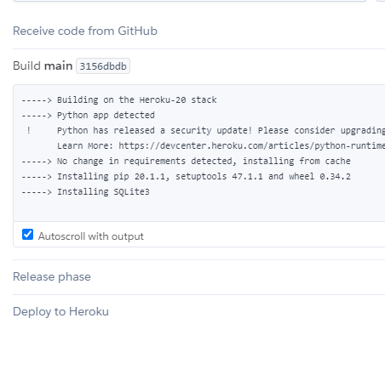
Installing the application libraries from GitHub to Heroku

Slide 16
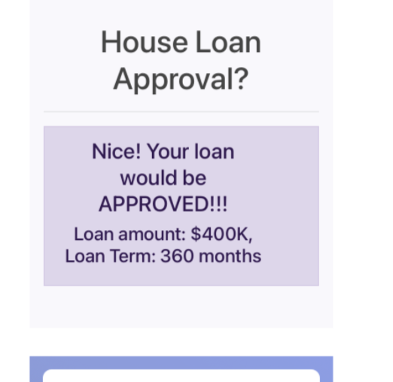
Demonstration: App hosted on Heroku
https://loan-predictions.herokuapp.com/

